Slide 1

Introducing Kanban
Balancing Work In Process And Capacity

Slide 2

Notes:
More work than time

Slide 3

Notes:
Massive batch and queue size with waterfall
Learned that lesson and Agile Manifesto was born

Slide 4

Notes:
Large batches of work build up over time and across each phase

Slide 5
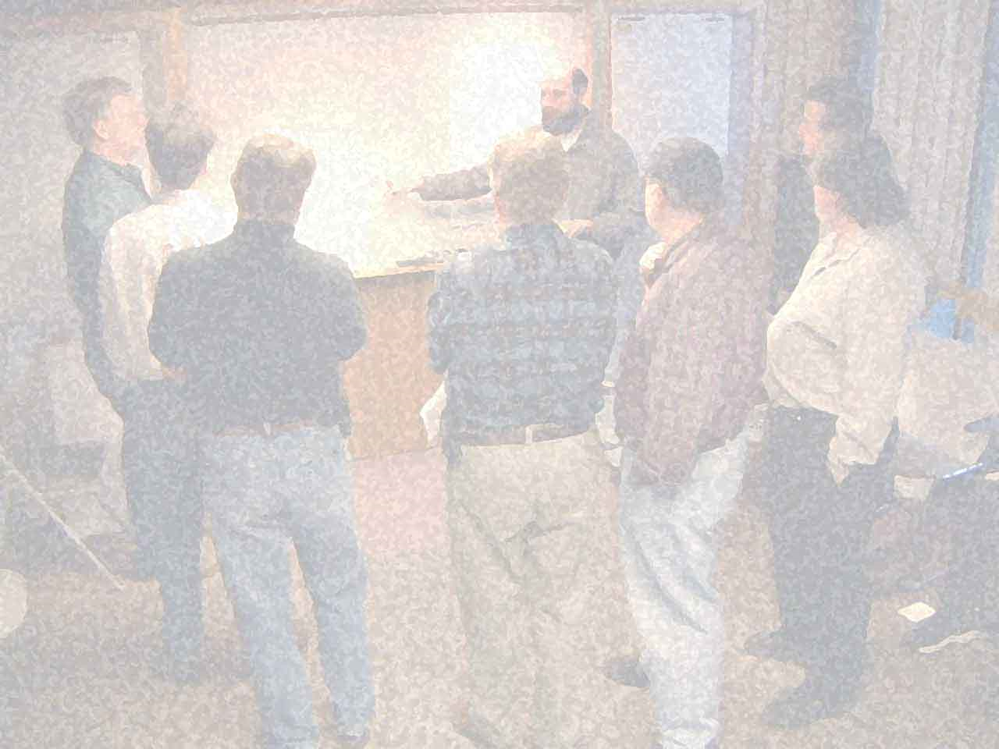
We are uncovering better ways of developing software by doing it and helping others do it.
Notes:
Agile Manifesto got it right

Slide 6

Notes:
Iterative != timebox
not everything fits into a 2 week iteration or 1 month sprint
Rhythm and cadence can be complex when dealing with multiple aspects of the process

Slide 7

Notes:
needs change without regard to time boxes
With even a small change, schedules are thrown out the window and we scramble to catch up
We (industry) seem to be stuck in reactionary mode instead of proactive approach

Slide 8
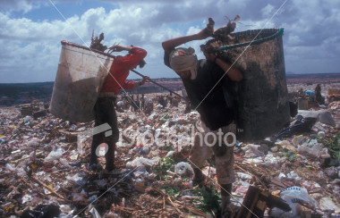
Lean Thinking
Notes:
Eliminate waste
Systems thinking
Continuous improvement

Slide 9
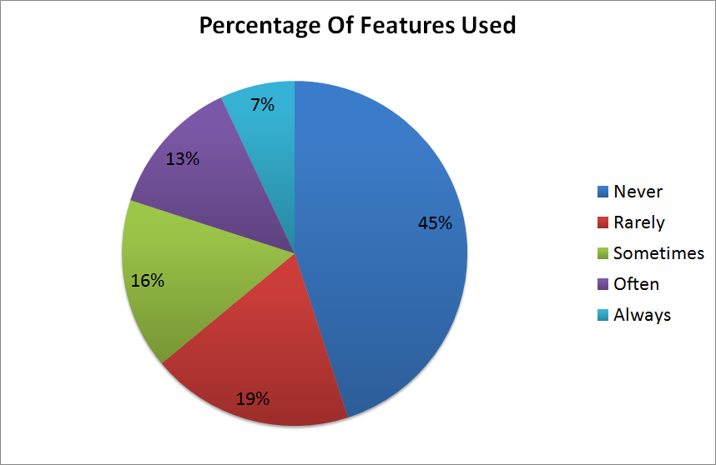
Source: Standish Group CHAOS Study
Notes:
Massive waste in overproduction of features

Slide 10

Notes:
Whole value stream
flow of value through entire process, not just development effort
Scrum and XP tend to focus on the development team only

Slide 11

Notes:
Defect prevention
Reduce lead time
Increase quality

Slide 12

Lean Tools
Notes:
Drawn from many other process improvement programs and sources

Slide 13

start
finish
Notes:
Value stream mapping
Showing all of the steps that it takes to get from input to delivered value

Slide 14

Notes:
Production leveling
Reducing variance in work items to balance flow of value and increase feedback

Slide 15

Notes:
Andon – stop the line when an error is found.
Jidoka – autonomation. Automation with a human touch. Stop and fix it now. CI and broken builds. Big flashing lights, etc.

Slide 16

Notes:
Root cause analysis: 5 why’s
Not who, but why
Poka-Yoke - Mistake proofing: put in measures to prevent the problem in the future

Slide 17

Notes:
PDCA: plan do check act
Process improvement
Kaizen: Continuous improvement
Like peeling an onion that never ends

Slide 18

Notes:
Pull systems – authorizing work based on capacity, not schedule

Slide 19

Getting Started

Slide 20
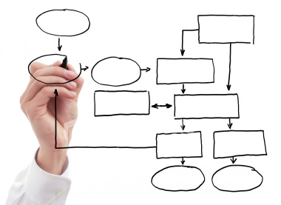
Notes:
Visualize your process
It’s your process, kanban won’t force a process on you

Slide 21
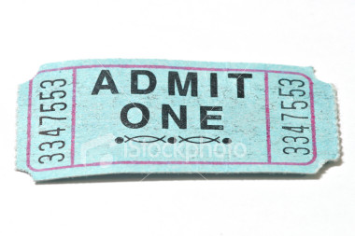
Notes:
Limit work in process

Slide 22

Notes:
Pull, don’t push
(run kanban simulation here)

Slide 23

Notes:
Monitor and improve

Slide 24

Metrics & Beyond

Slide 25

Notes:
The mechanics of kanban are necessary but not sufficient
Kanban as change management system

